Slide 1


Exploratory Data Analysis of Global Earthquake Records (1969–2018)
TITLE
CREATED BY
OJIRIKA JOHN OJIRIKA
30/06/2026

Slide 2

TABLE OF CONTENTS
- Introduction
-Exploratory Analysis
-Summary
-Conclusion

Slide 3


INTRODUCTION
Earthquakes are among the most destructive natural disasters, and analyzing their historical data provides valuable insights into seismic activity patterns. This study connects to a MySQL database containing earthquake records from 1969 to 2018, stored in the earthquake_tb table. Using Python, Pandas, and visualization libraries such as Seaborn and Matplotlib, exploratory data analysis (EDA) was conducted to uncover trends in magnitude, depth, geographic distribution, and temporal occurrence. The dataset includes over 23,000 earthquake events with attributes such as location, magnitude, depth, and cause.

Slide 4

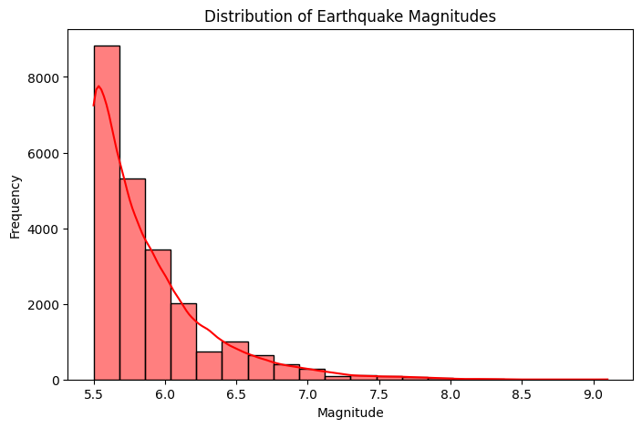
INTERPRETATION OF YOUR MAGNITUDE DISTRIBUTION GRAPH
Lowest Magnitude: The dataset starts at 5.5, which is the minimum recorded earthquake magnitude.
Highest Magnitude: The maximum recorded magnitude is 9.1, though very few earthquakes reach this level.
Summary of the Graph
The histogram shows that most earthquakes cluster between 5.5 and 6.0, with thousands of events in this range.
As magnitude increases, the frequency drops sharply — earthquakes above magnitude 7 are rare, and those above 8 are extremely rare.
The smooth red curve (KDE line) confirms this trend, showing a steep decline in probability as magnitude rises.
This pattern reflects a well-known seismological principle: small to moderate earthquakes occur far more frequently than large, destructive ones.
Generally, the dataset is dominated by moderate earthquakes (5.5–6.0), while very strong quakes (8–9+) are exceptional events.

Slide 5


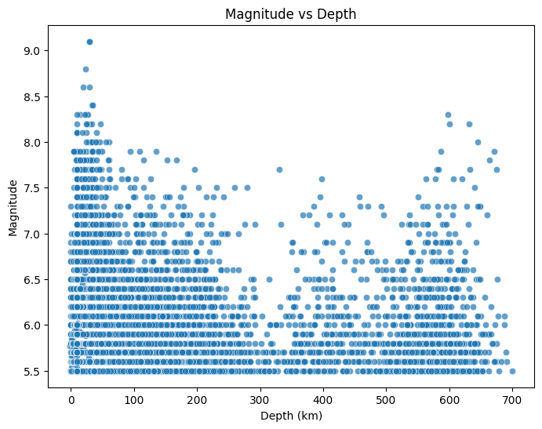
IDENTIFY WHETHER STRONGER EARTHQUAKES TEND TO OCCUR AT CERTAIN DEPTHS IN THE MAGNITUDE VS DEPTH SCATTER PLOT
Findings
Shallow earthquakes (0–100 km) are the most common. The majority of points cluster here, especially around magnitudes 5.5–6.5.
Intermediate-depth earthquakes (100–300 km) occur less frequently, but some still reach magnitudes above 6.5.
Deep earthquakes (300–700 km) are rare, and while they do occur, they generally show moderate magnitudes (5.5–7.0).
The largest magnitudes (8–9+) tend to appear at shallower depths, reinforcing the idea that destructive earthquakes are usually shallow.
Summary
The scatter plot demonstrates that stronger earthquakes are more likely to occur at shallow depths, where tectonic plates interact directly near the Earth’s surface. Shallow quakes are not only more frequent but also more hazardous because their energy is released closer to populated areas. Deeper earthquakes, while less common, can still be significant but generally don’t reach the extreme magnitudes seen at shallow depths.
shallow earthquakes dominate both in frequency and in strength, making them the most critical for risk assessment and disaster preparedness.

Slide 6
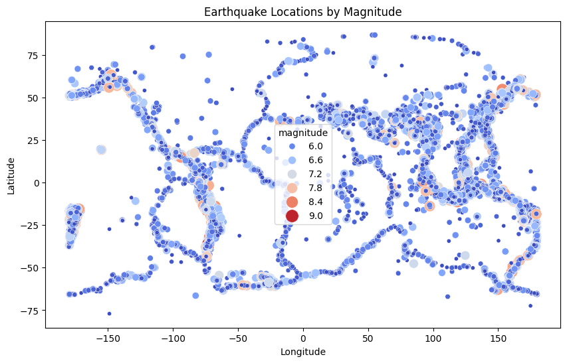
EARTHQUAKE DISTRIBUTION BY GEOGRAPHIC
Highest Magnitude (≈ 9.0)
  Represented by the largest red circles.
  These are concentrated along the Pacific Ring of Fire — especially near Japan, Chile, and Indonesia.
  Indicates extremely powerful seismic activity in subduction zones.
Lowest Magnitude (≈ 6.0)
  Shown as small blue circles.
  Spread more widely but still clustered along tectonic boundaries.
  Common in regions like California, Alaska, and parts of South America.
Summary
Earthquakes are not randomly distributed; they align with tectonic plate boundaries.
The Pacific Ring of Fire dominates both high and low magnitude events.
Larger quakes (8.0–9.0) are rarer but highly concentrated, while smaller ones (6.0–7.0) are more frequent and widespread.

Slide 7
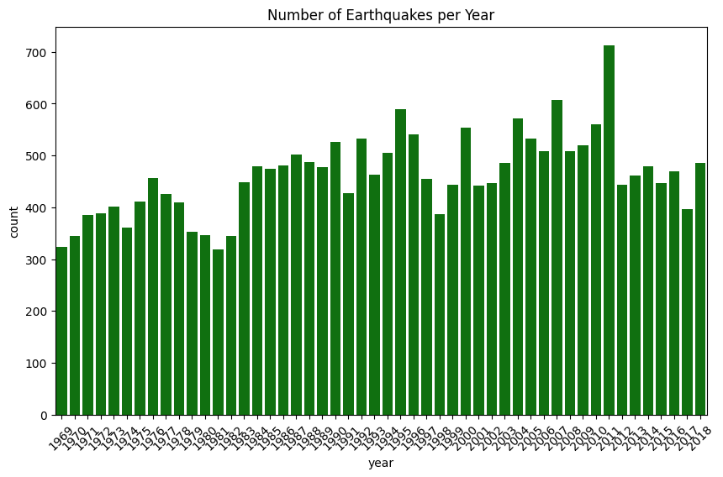
EARTHQUAKE FREQUENCY OVER TIME
Lowest Counts (≈ under 200 per year)
Seen in the early years (1970s).
Earthquake reporting was relatively sparse compared to later decades.
Moderate Activity (≈ 300–500 per year)
Most of the 1980s and 1990s fall in this range.
Noticeable peaks in the late 1980s and early 2000s.
Highest Spike (≈ 700 earthquakes)
Around 2011, the chart shows a dramatic surge.
This aligns with major seismic events globally (e.g., the 2011 Japan earthquake and tsunami).
Summary
Earthquake counts fluctuate year to year, but the overall trend shows increasing frequency over time.
The 2011 peak stands out as the most significant anomaly in the dataset.
Improved monitoring and global reporting likely contribute to higher counts in recent decades, alongside actual seismic activity.

Slide 8



SUMMARY
The dataset comprises 23,119 earthquake events recorded globally between 1969 and 2018.
Magnitude: Most earthquakes fall within the 5.5–6.0 range, with the maximum recorded magnitude being 9.1.
Depth: Shallow earthquakes (<70 km) dominate the dataset, though depths extend up to 700 km.
Geographic Distribution: Dense clusters of seismic activity are observed along the Pacific Ring of Fire, including Alaska, Banda Sea, and the South Sandwich Islands.
Temporal Trends: Earthquake frequency varies across years, with certain periods showing heightened activity.
Data Quality: No missing values were detected, and the dataset is consistent across all columns.
Visualizations highlight that shallow earthquakes are more frequent and often more destructive, while deeper ones, though less common, can still reach significant magnitudes.

Slide 9

CONCLUSION
The exploratory analysis reveals that global seismic activity is concentrated in tectonically active regions,
particularly around the Pacific Ring of Fire. Most earthquakes are moderate in magnitude (5–6), but occasional high-magnitude events underscore the importance of continuous monitoring. Shallow earthquakes are more prevalent and pose greater risks to human settlements. Temporal analysis shows fluctuations in earthquake occurrences, suggesting periods of heightened seismic activity.
Generally, this dataset provides a strong foundation for further predictive modeling and risk assessment in seismology.

